Slide 1

SWE 425: Telecommunication Engineering
Md. Habibur Rahman
Lecturer, Department of Software Engineering

Slide 2
Bandwidth Utilization: Multiplexing and Spreading

Slide 3
Bandwidth Utilization:
In real life, we have links with limited bandwidths.
The wise use of these bandwidths has been, and will be, one of the main challenges of Telecommunications.
Bandwidth utilization is the wise use of available bandwidth to achieve specific goals.
We explore two broad categories of bandwidth utilization: multiplexing and spreading.
In multiplexing, our goal is efficiency; we combine several channels into one.
In spreading, our goals are privacy and anti jamming; we expand the bandwidth of a channel.

Slide 4
Multiplexing:
Whenever the bandwidth of a medium linking two devices is greater than the bandwidth needs of the devices, the link can be shared.
Multiplexing is the set of techniques that allows the simultaneous transmission of multiple signals across a single data link.
If the bandwidth of a link is greater than the bandwidth needs of the devices connected to it, the bandwidth is wasted.
Bandwidth is one of the most precious resources we have in communications.

Slide 5
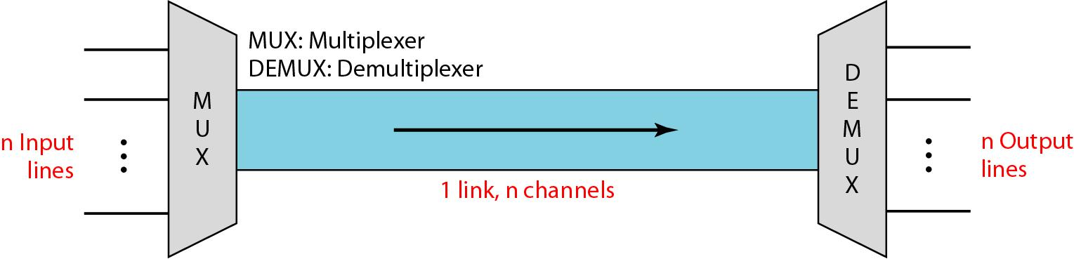
Multiplexing:

Slide 6
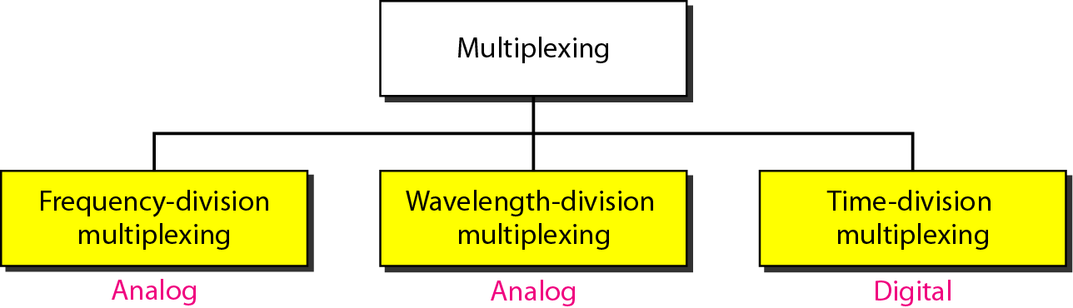
Categories of multiplexing

Slide 7
Frequency Division Multiplexing (FDM):
FDM is an environment in which the entire frequency band available on the communications link is divided into smaller individual bands or channels.
Each user is assigned to a different frequency.
The signals all travel in parallel over the same communications link, but they are divided by frequency
A disadvantage of FDM is that they can be difficult to reconfigure in an environment.
For instance, to increase the capacity of Channel 1 you would also have to squeeze Channels 2, 3, and 4 to accommodate that change.

Slide 8
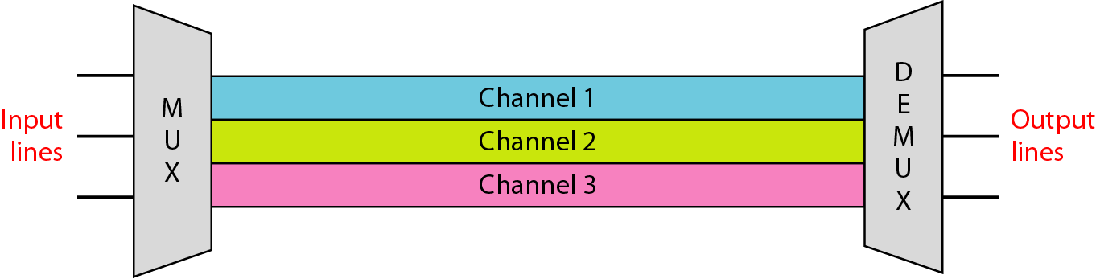
Frequency-division multiplexing

Slide 9
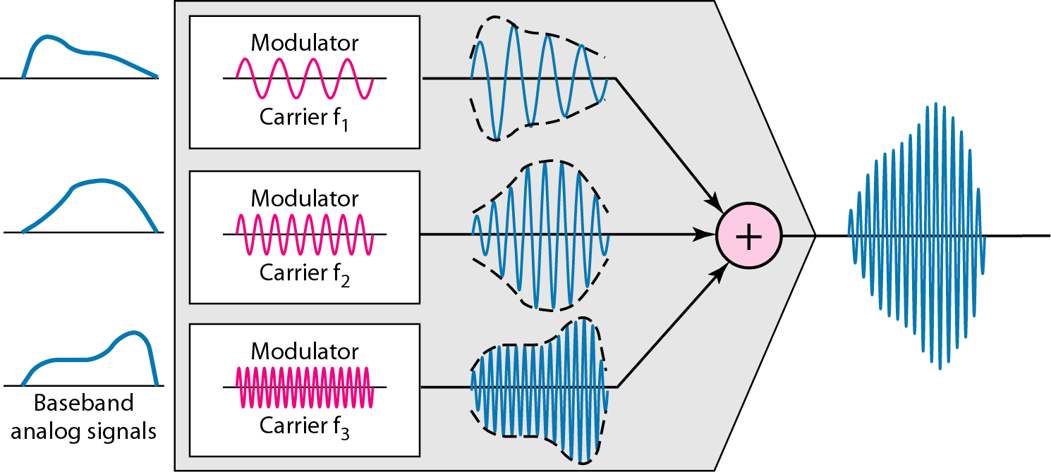
FDM process

Slide 10
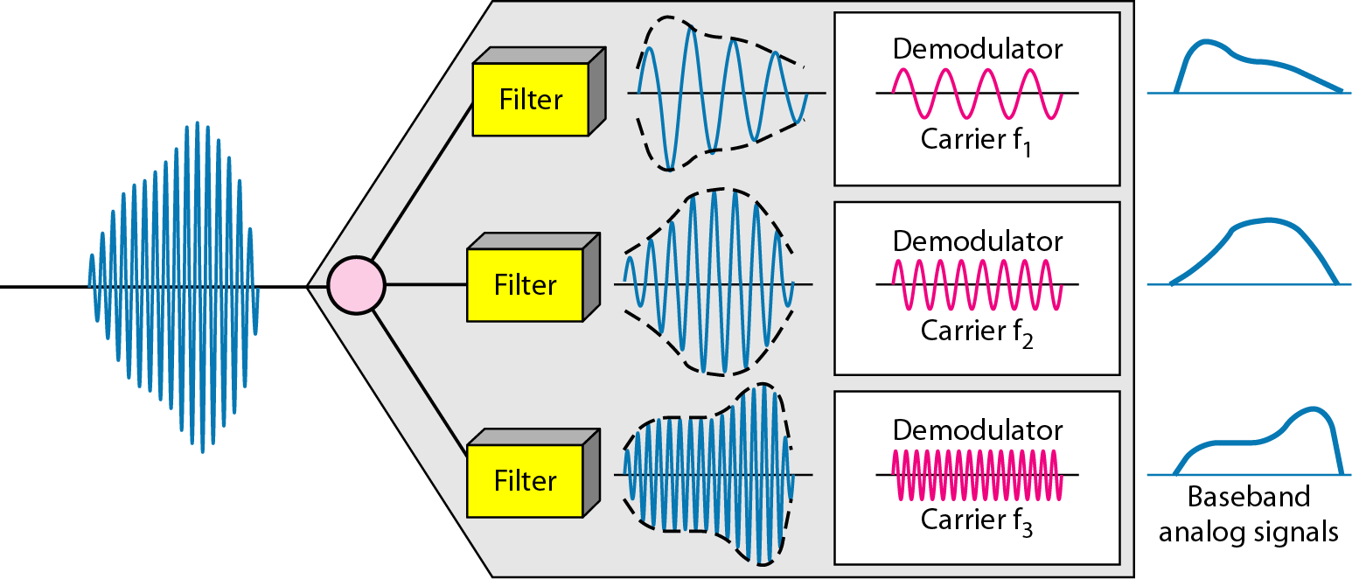
FDM De-multiplexing example

Slide 11
Frequency Division Multiplexing (FDM):
Given the environment today, we don't make great use of FDM, but it is still used extensively in cable TV and in radio.
In cable TV, multiple channels of programming all coexist on the coax coming into your home, and they are separated based on the frequency band in which they travel.
When you enter a channel number on your set-top box or cable-ready TV, you're essentially indicating to the network what portion of the frequency band it's traveling on.

Slide 12
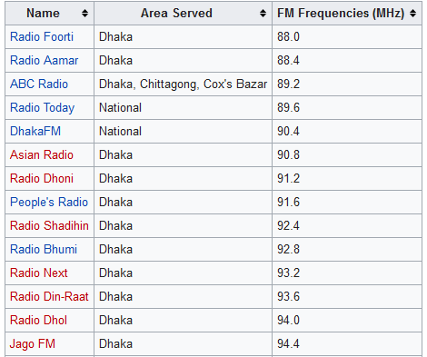
Privately Owned Radio Stations

Slide 13
Satellite TV Channels
Channel Name | Frequency
ATN News | 3998 MHz
Channel 9 | 3793 MHz
BTV | 4129 MHz
Maasranga | 3812 MHz
Gazi TV | 3805 MHz
Channel 24 | 3815.75 MHz

Slide 14
Example
Assume that a voice channel occupies a bandwidth of 4 kHz. We need to combine three voice channels into a link with a bandwidth of 12 kHz, from 20 to 32 kHz. Show the configuration, using the frequency domain. Assume there are no guard bands.
Solution
We shift (modulate) each of the three voice channels to a different bandwidth, as shown in Figure 6.6. We use the 20- to 24-kHz bandwidth for the first channel, the 24- to 28-kHz bandwidth for the second channel, and the 28- to 32-kHz bandwidth for the third one. Then we combine them as shown in next figure.

Slide 15
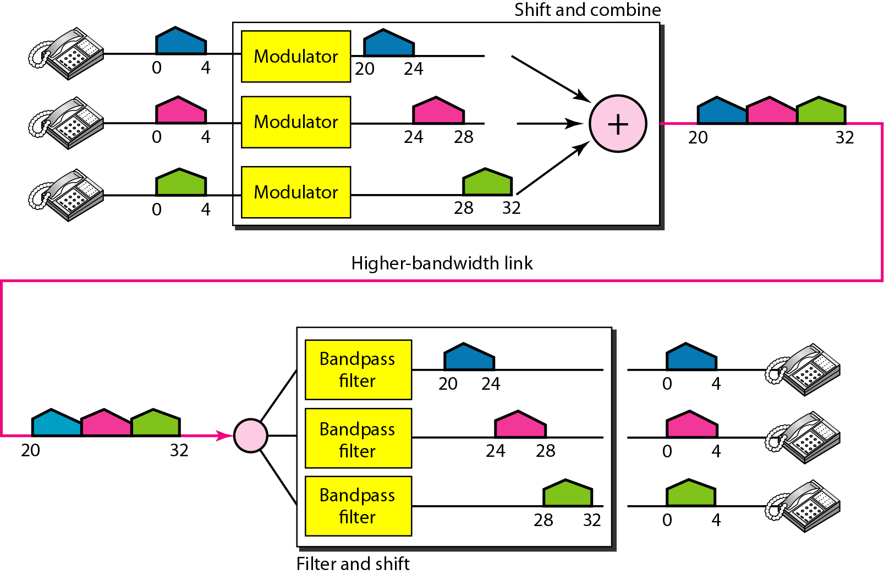
Solution

Slide 16
Example
Assume that a voice channel occupies a bandwidth of 4 kHz. We need to combine four voice channels into a link with a bandwidth of 20 kHz, from 30 to 56 kHz. Show the configuration, using the frequency domain. Assume there are 2kHz guard bands.

Slide 17
Wavelength Division Multiplexing (WDM)
In fiber-optic communications, wavelength-division multiplexing (WDM) is a technology which multiplexes a number of optical carrier signals onto a single optical fiber by using different wavelengths (i.e., colors) of laser light.
This technique enables bidirectional communications over one strand of fiber, as well as multiplication of capacity

Slide 18
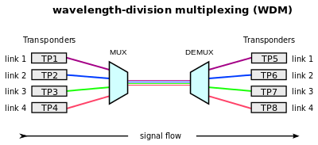

Slide 19
Time Division Multiplexing (TDM):
In TDM, a dedicated time slot is provided for each port or point of interface on the system.
Each device in a predetermined sequence is allotted a time slot during which it can transmit.
That time slot would enable one character of data, or 8 bits of digitized voice, to be placed on the communications link.
The allocated time slots have to be framed in order for the individual channels to be separated out.

Slide 20
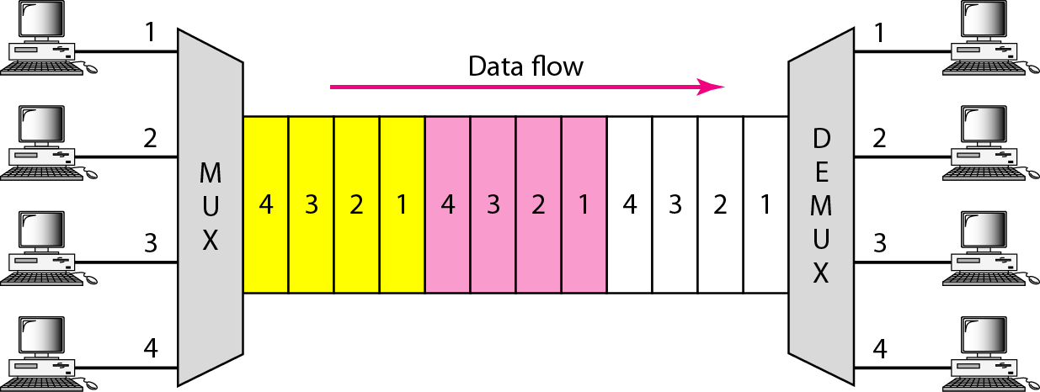
Time Division Multiplexing (TDM)

Slide 21
Synchronous Time Division Multiplexing
Data rate of medium exceeds data rate of digital signal to be transmitted
In synchronous TDM, each device is given same time slot to transmit the data over the link, irrespective of the fact that the device has any data to transmit or not. Hence the name Synchronous TDM. Synchronous TDM requires that the total speed of various input lines should not exceed the capacity of path.
Each device places its data onto the link when its time slot arrives i.e. each device is given the possession of line turn by turn.
If any device does not have data to send then its time slot remains empty. So, time slots allocated even if no data
The various time slots are organized into frames and each frame consists of one or more time slots dedicated to each sending device.
If there are n sending devices, there will be n slots in frame i.e. one slot for each device.

Slide 22
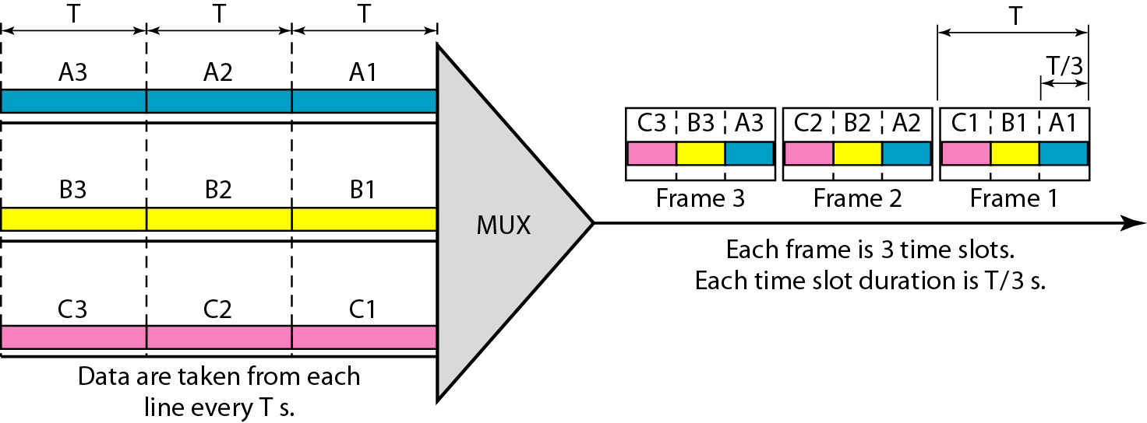
Synchronous Time-Division Multiplexing

Slide 23
Asynchronous TDM
It is also known as statistical time division multiplexing.
Asynchronous TDM is called so because is this type of multiplexing, time slots are not fixed i.e. the slots are flexible.
Here, the total speed of input lines can be greater than the capacity of the path.
In synchronous TDM, if we have n input lines then there are n slots in one frame. But in asynchronous it is not so.
In asynchronous TDM, if we have n input lines then the frame contains not more than m slots, with m less than n (m < n).
In asynchronous TDM, the number of time slots in a frame is based on a statistical analysis of number of input lines.
In this system slots are not predefined, the slots are allocated to any of the device that has data to send.
The multiplexer scans the various input lines, accepts the data from the lines that have data to send, fills the frame and then sends the frame across the link.
If there are not enough data to fill all the slots in a frame, then the frames are transmitted partially filled.
Asynchronous Time Division Multiplexing is depicted in fig. Here we have five input lines and three slots per frame.

Slide 24
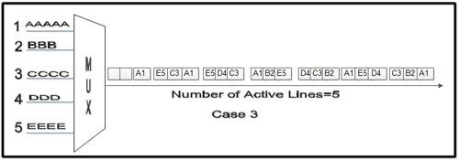

Slide 25
Advantages of TDM
Time division multiplexing systems are more flexible than frequency division multiplexing.
Full available channel bandwidth can be utilized for each channel
Inter-modulation distortion is absent.
The problem of crosstalk is not severe.
Time division multiplexing circuitry is not complex.

Slide 26
Disadvantages of TDM
Synchronization is required in time division multiplexing.
Complex to implement.
Due to slow narrowband fading, all the TDM channels may get wiped out.

Slide 27
Thank You !!!
Any Questions ???

